Slide 1
Lesson 1 Task
Fill up the Porter Gale Funnel Test reflecting your passion as an entrepreneur.
Fill up the Personal Business Model Canvas showing your desired framework of your business practice.
For every customer defined, create a customer empathy map to document your understanding of them.
This will serve as input on your digital marketing messages and communications.

Slide 2
Porter Gale FUNNEL TEST
E-Commerce
Education
People
Sweet Spot
Change
Empower individuals with e-commerce wisdom and skills they can use in sustaining business, advocacy, achieve better quality of life.
– Janette Toral

Slide 3
Porter Gale FUNNEL TEST
Passion
Passion
Passion
Sweet Spot
TONE
Purpose

Slide 4
Jan
Janette Toral
E-Commerce Boot Camp
Digital Influencer Boot Camp
Blog Network
Software Process Improvement
Blog & Social Media Entrepreneur Course
DigitalFilipino Club
DigitalFilipino.com
E-Commerce Entrepreneurs needing advise or support.
Bloggers wants to earn income.
Advertisers reach out to bloggers.
Individuals interested in digital marketing.
Companies need help in process imrpovement
”Samurai”
Educational institutions (UP-ITDC, AIE College, STI, and Ateneo Rockwell)
DigitalFilipino Club members
eLearning Edge
Teaching Face2Face / online
Learning
Writing articles
Consultation
Organize events
One-on-one
Online consultation
(online meetings or exclusive forums)
DigitalFilipino.com
Knowledge on e-commerce, digital marketing, blogging
Social Media
Blog
Webinar
Forums
Mobile, Email
Website, Books
Webinars,
Educational videos
Boot camps
Club members, training opportunities, speaking engagements, recognition, awards, friendship with community members, DigitalFilipino Start up 100 Project

Slide 6
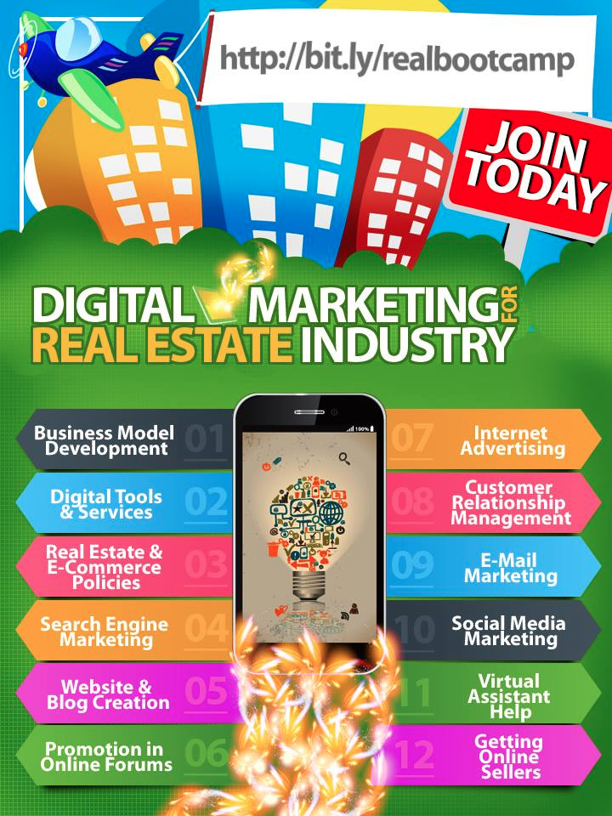
Started October 3, 2013
P2, 500 for one year.

Slide 7
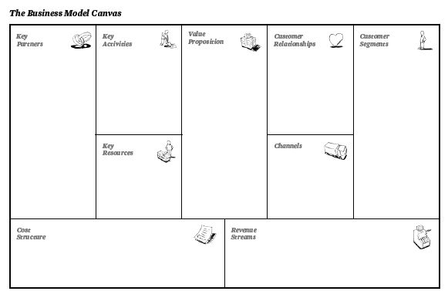
Digital Marketing for Real Estate
Business Model Canvas
“Samurais”
DigitalFilipino Club Members
Schools
Government
Event planners
Communities
PRC - later
Teaching online and offline.
Site update
Consultation
Advertising
Research
Learn online for one year
Can be taken anywhere, anytime online.
Research-based Consultation and learning
Start-Up 100 Project
One-on-one.
Self-service.
Group.
Real Estate Service Professionals who would like to learn digital marketing to boost business.
Social network.
E-mail.
Online Boot Camp
Mobile.
F2F Training
E-Learning platform
Veteran player
Telecommunication cost.
Site upgrades.
Advertising budget
Webinar platform
Content development
Protégé membership
Face to Face Training fees
Start-Up 100 investment
ECOM / DIM Summit

Slide 8
Business Model Canvas

Slide 9
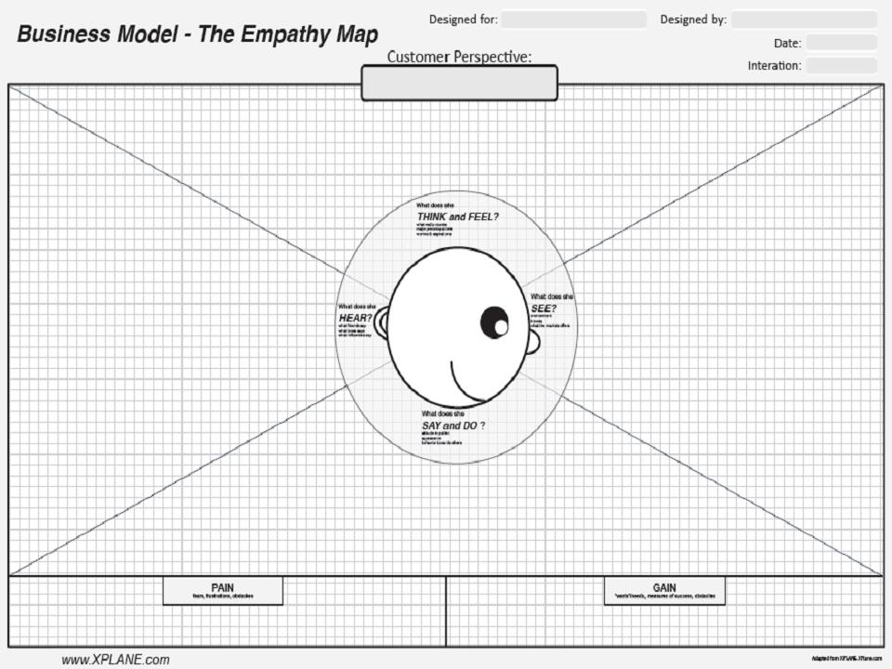
Digital Marketing for Real Estate Industry Program
Janette Toral
Real Estate Service Professional
What really counts: Get continuing leads-sales-referrers online.
Major preoccupation: Sustaining revenue / income. Growing family.
Worries: Not making a sale. Making ends meet.
Aspiration: Quality lifestyle. Industry recognition.
Friends say: “You should market online.”
Environment: Many RESP marketing online.
Boss say: “Go where the market is. Hit your quota.”
Friends: Uses social media to market online.
Market offers: Various digital marketing and e-commerce training (generic in format)
Influencers say: “Don’t hard sell or spam online.”
Behavior towards others:
Observant. May follow lead of others.
Appearance:
Eager & open for partnerships online.
Attitude in public:
Competitive. Upbeat.
Enthusiastic.
Fears: Not competitive with peers.
Frustration: Not getting results.
Wants / Needs: Quality leads.
Top of mind.
Measure success:
Sales conversion.
Authority status.
Obstacle: Managing time and resource.
Obstacle: Prioritizing and managing tasks.

Slide 11
References
Business model generation http://www.slideshare.net/HFincubator/business-model-generation-14863157
Business model YOU http://www.ideogram.us/BMY_preview/Business_Model_You_preview.pdf
Porter Gale Funnel Test http://www.influentialblogger.net/2013/06/what-brings-you-success-head-heart-or.html

