Slide 1
Accepting E-Commerce Payments Online with Dragonpay
Janette Toral
DigitalFilipino.com

Slide 2
Disclaimer
All text and images used in this presentation material were lifted from the various Internet Payment Service Provider (IPSP) websites.
Sources are acknowledged for proper reference and reader verification.
It is meant for educational purposes only. No copyright infringement is intended.
An IPSP who wants to be removed or would like to give updated information can email Janette Toral at digitalfilipino@gmail.com (Message her on Facebook once sent at http://facebook.com/digitalfilipino)

Slide 3
Dragonpay Online Payment Collection
Facilitates payment through
Online banking (P10 per transaction)
Over the counter banking (P15 per transaction)
Over the counter non-banks (P20 per transaction)
One-time set-up fee of P28,000.
For low value items, micropayments plan is suggested. Pay 5% charges rather than fixed fees.
http://www.dragonpay.ph/online-payments

Slide 4
Dragonpay with BancNet Online Banking
Only works with member banks that allows interbank fund transfer.
P25 per transaction fee
http://www.dragonpay.ph/bancnet-online-how-to

Slide 5
BancNet Interbank Fund Transfer
Allied Bank
Allied Savings Bank
Asia United Bank
Chinatrust
CityState Savings Bank
Development Bank of the Philippines (DBP)
Equicom Savings Bank
Enterprise Bank
Isla Bank
Landbank
Malayan Savings Bank
Maybank
Philippine Bank of Communications (PBCom)
Philippine Business Bank
Philtrust Bank
Postal Bank
QCRB
Robinsons Bank
Security Bank
Security Savings Bank
Standard Chartered Bank
Sterling Bank of Asia
UCPB Savings Bank (not the regular UCPB commercial bank)
Veterans Bank
Wealth Bank
World Partners Bank
http://www.dragonpay.ph/bancnet-online-how-to

Slide 6
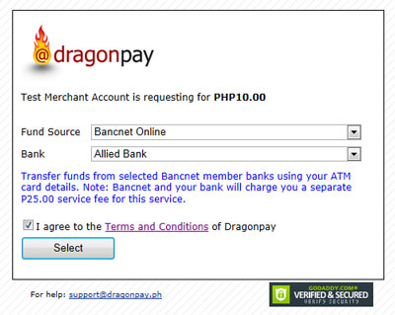
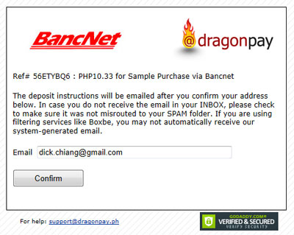
Dragonpay payment with BancNet
Step 1: Customer selects BancNet Online from the dropdown list of Fund Sources.
Bank will charge customer a service fee of PHP25.00. The fee is shared between customer bank and BancNet.
Step 2: Customer needs to confirm email address. Dragonpay will send its instructions and payment confirmation via email.
http://www.dragonpay.ph/bancnet-online-how-to

Slide 7
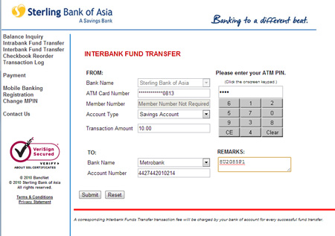
Dragonpay payment with BancNet
Step 3:
1. Customer opens the email instruction received from Dragonpay after the confirmation in Step 2.
2. Customer logs in to BancNet Online link in item #1 of the instruction.
Customer will be directed to the BancNet Online page of your bank.
3. Customer clicks the “I Agree” to proceed.
4. Customer chooses Interbank Fund Transfer from the list of menu options. Provides ATM card details and PIN accurately.
In the “TO:” section, select bank indicated in the email instruction. Click the Submit button when done.
http://www.dragonpay.ph/bancnet-online-how-to

Slide 8
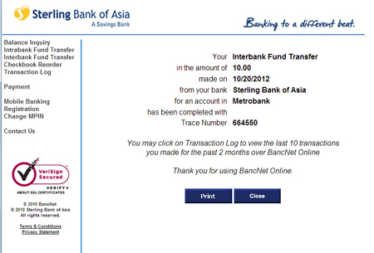
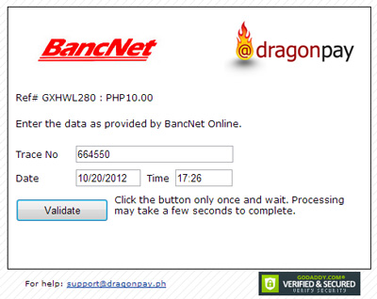
Dragonpay payment with BancNet
Step 4: If fund transfer is successful, BancNet Online will display a 6-digit Trace No.
This number will be used by the customer to verify fund transfer with Dragonpay.
Step 5: Customer clicks the validation link indicated in the Dragonpay email instruction. Enter the Trace No. when prompted and click the Validate button to complete the payment cycle.
http://www.dragonpay.ph/bancnet-online-how-to

Slide 9
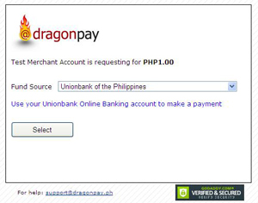
Dragonpay payment with Unionbank Internet Banking
Step 1: Shop online and go through the normal checkout process. Choose Dragonpay as the payment option.
Step 2: Customer will be prompted for the payment fund source. Choose among the Online Bank payment options.
http://www.dragonpay.ph/how-to-use-dragonpay-online-bank-deposit

Slide 10
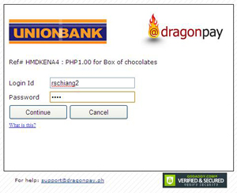
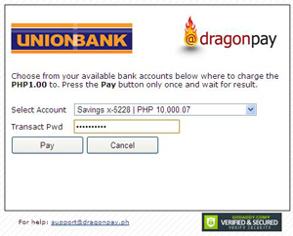
Dragonpay payment with Unionbank Internet Banking
Step 3: Customer will be prompted for their Unionbank Internet Banking login id and password. Enter it correctly and click the Continue button to proceed.
Step 4: Dragonpay will retrieve the bank accounts enrolled for Internet banking facility and present it in a dropdown list. Customer chooses the account they wish to debit the payment from. click the Pay button to authorize Dragonpay to charge the online purchase from that account.
Note on step 4: Some bank requires transaction password that is different from login password.
http://www.dragonpay.ph/how-to-use-dragonpay-online-bank-deposit

Slide 11
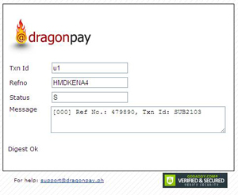
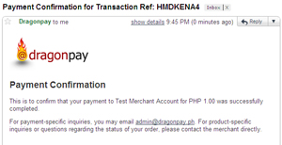
Dragonpay payment with Unionbank Internet Banking
Step 5: Upon completion, customer will be redirected back to the merchant site. Be informed by the merchant on the completion status — whether successful or not.
Step 6: Dragonpay will send a confirmation to customer email address with the status of the payment — whether successful or not.
Merchant usually does the same too.
http://www.dragonpay.ph/how-to-use-dragonpay-online-bank-deposit

Slide 12
Dragonpay Over the Counter Banking
Over the Counter Deposits
Banco de Oro
Bank of the Philippine Islands
Metrobank
Rizal Commercial Banking Corp
Chinabank
EastWest Bank
Landbank
Maybank
Philippine National Bank
RobinsonsBank
Security Bank
Sterling Bank of Asia
United Coconut Planters Bank (UCPB)
Unionbank
http://www.dragonpay.ph/online-payments

Slide 13
Dragonpay Over the Counter Banking
ATM-based payments
Banco de Oro
Bank of the Philippine Islands
Unionbank
Chinabank
Maybank
Rizal Commercial Banking Corp
Philippine National Bank
United Coconut Planters Bank (UCPB)
http://www.dragonpay.ph/online-payments

Slide 14
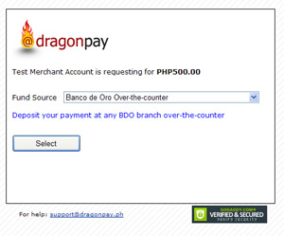
Dragonpay payment through offline bank deposit
Step 1: Shop online. Choose Dragonpay as the payment option at Checkout.
Step 2: Customer will be prompted for the payment fund source. Choose among the Over-the-counter Bank payment options.
http://www.dragonpay.ph/how-to-use-dragonpay-offline-bank-deposit

Slide 15
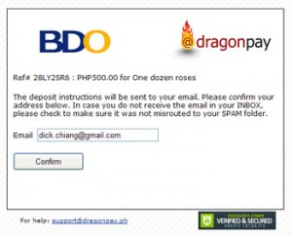
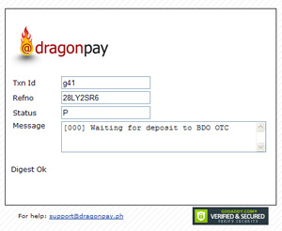
Dragonpay payment through offline bank deposit
Step 3: Customer enters email address. Dragonpay will send the deposit instructions via email so make sure the address provided is correct.
Step 4: After clicking the Confirm button, customer will be redirected back to the merchant’s website. At this point, customer payment is in Pending status. The merchant will not fulfill the order yet until payment cycle with Dragonpay is completed.
http://www.dragonpay.ph/how-to-use-dragonpay-offline-bank-deposit

Slide 16
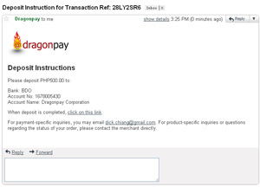
Dragonpay payment through offline bank deposit
Step 5: Customer checks email. Deposit instruction that has has bank account details sent in Step 4 should have been received already.
http://www.dragonpay.ph/how-to-use-dragonpay-offline-bank-deposit

Slide 17
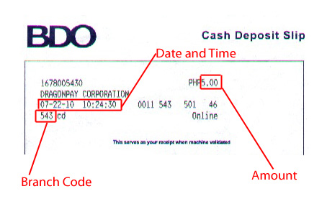
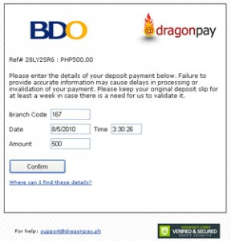
Dragonpay payment through offline bank deposit
http://api.dragonpay.ph/Bank/WhereIs.aspx?procid=BDOX
Step 6: After deposit, teller will give validated slip that has details including date and time of the transaction, code/name of the bank branch, and amount paid. Check last email received from Dragonpay and fill-in deposit details.
http://www.dragonpay.ph/how-to-use-dragonpay-offline-bank-deposit

Slide 18
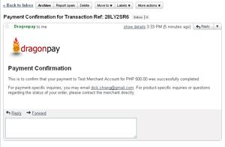
Dragonpay payment through offline bank deposit
Step 7:
Upon successful validation of payment, Dragonpay sends an email to you for your records.
http://www.dragonpay.ph/how-to-use-dragonpay-offline-bank-deposit

Slide 19
Dragonpay Over the Counter Non-Bank
LBC branches
SM Payment counters
Robinsons Department Stores
M.Lhuillier branches

Slide 20
References
http://www.dragonpay.ph/online-payments
http://www.dragonpay.ph/bancnet-online-how-to
http://www.dragonpay.ph/how-to-use-dragonpay-online-bank-deposit
http://www.dragonpay.ph/how-to-use-dragonpay-offline-bank-deposit

